Slide 1
Web Technologies
By : Arpita Tiwari

Slide 2
Introduction
Web Technology refers to the various tools and techniques that are utilized in the process of communication between different types of devices over the internet.
A web browser is used to access web pages. Web browsers can be defined as programs that display text, data, pictures, animation, and video on the Internet.
Hyperlinked resources on the World Wide Web can be accessed using software interfaces provided by Web browsers.

Slide 3
Network
A network is a group of connected, communicating devices such as computers and printers. An internet (note the lowercase i) is two or more networks that can communicate with each other.
The most notable internet is called the Internet (uppercase I ), composed of hundreds of thousands of interconnected networks. Private individuals as well as various organizations such as government agencies, schools, research facilities, corporations, and libraries in more than 100 countries use the Internet.
Millions of people are users. Yet this extraordinary communication system only came into being in 1969.

Slide 4
2-1 LAYERED TASKS
We use the concept of layers in our daily life. As an example, let us consider two friends who communicate through postal mail. The process of sending a letter to a friend would be complex if there were no services available from the post office.
Topics discussed in this section:
Sender, Receiver, and Carrier Hierarchy

Slide 5
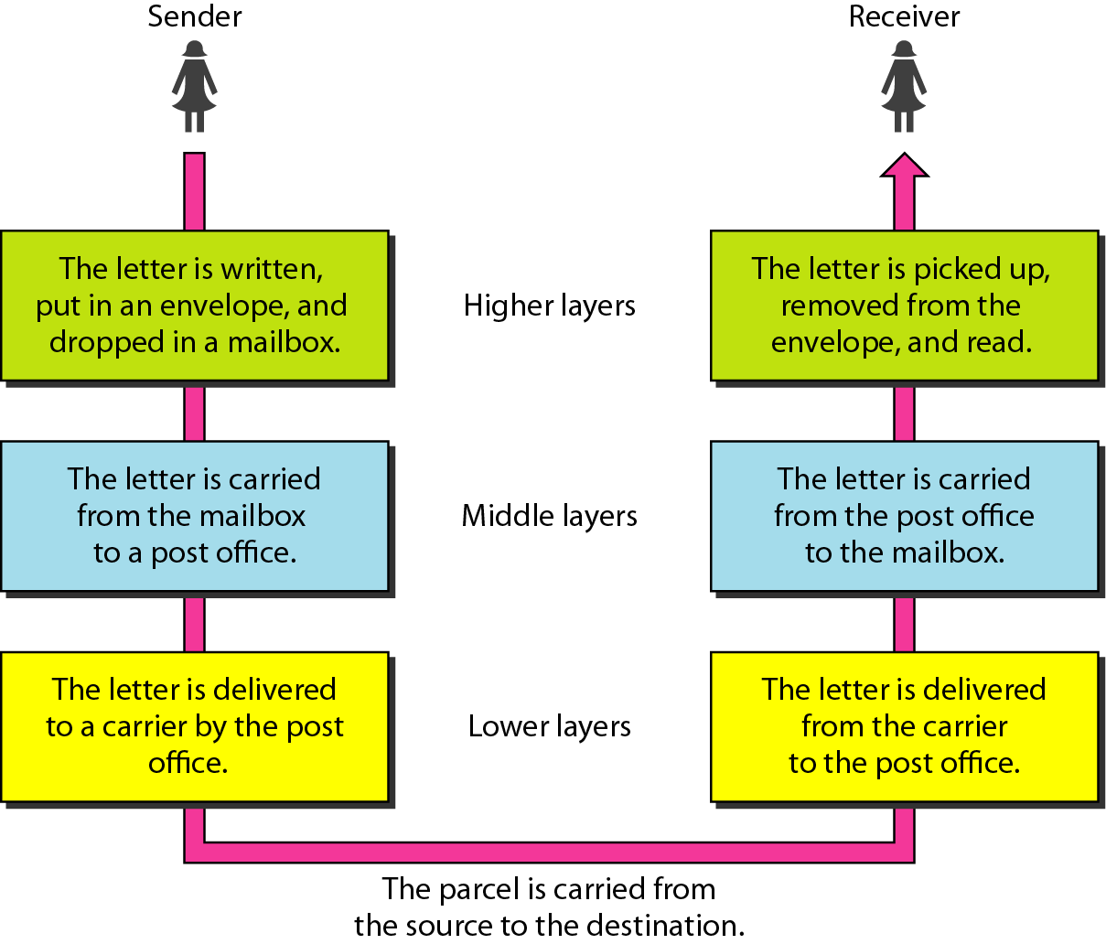
Figure 2.1 Tasks involved in sending a letter

Slide 6
2-2 THE OSI MODEL
Established in 1947, the International Standards Organization (ISO) is a multinational body dedicated to worldwide agreement on international standards. An ISO standard that covers all aspects of network communications is the Open Systems Interconnection (OSI) model. It was first introduced in the late 1970s. The OSI model is not a protocol; it is a model for understanding and designing a network architecture that is flexible, robust, and interoperable.
Topics discussed in this section:
Layered Architecture Peer-to-Peer Processes
Encapsulation

Slide 7

Note
ISO is the organization. OSI is the model.

Slide 8
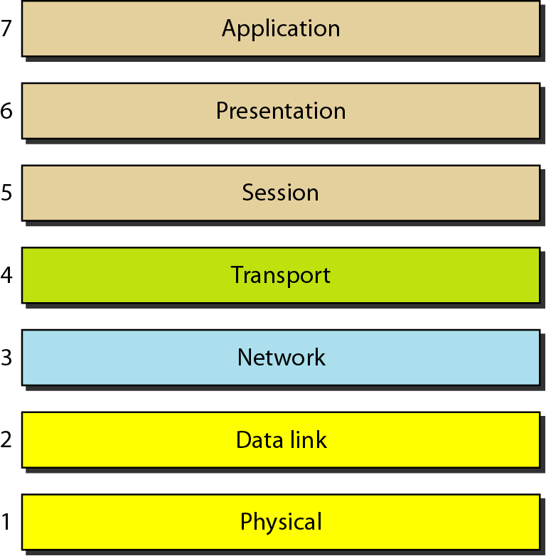
Figure 2.2 Seven layers of the OSI model

Slide 9
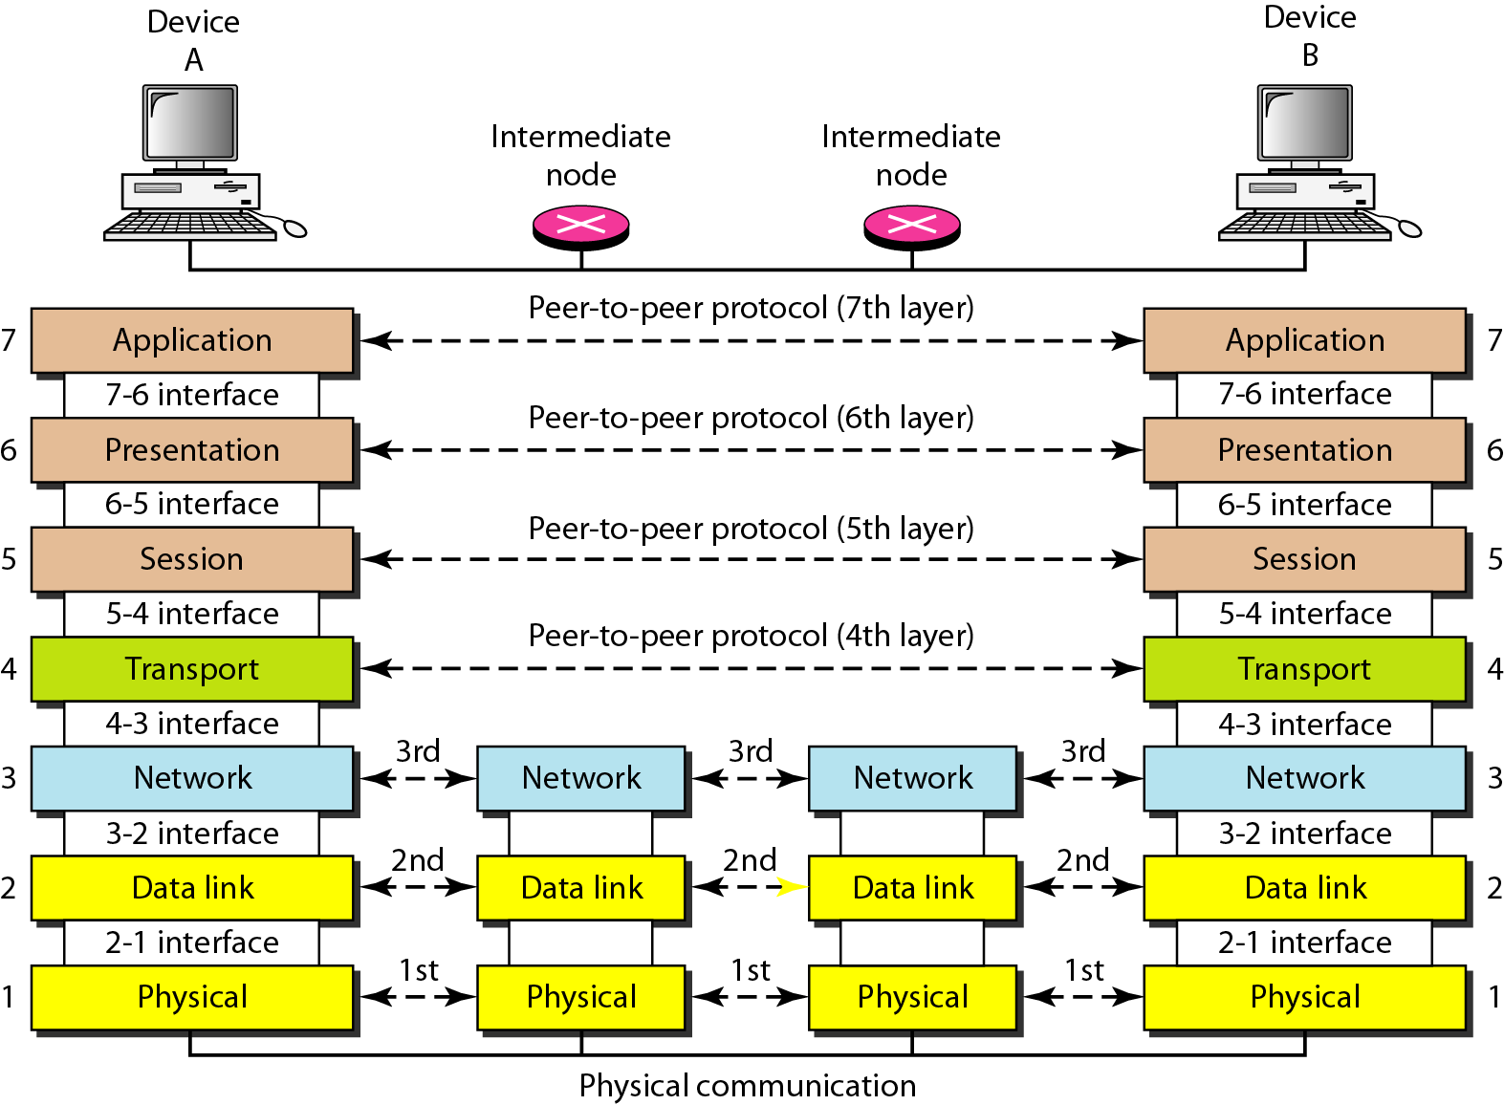
Figure 2.3 The interaction between layers in the OSI model

Slide 10
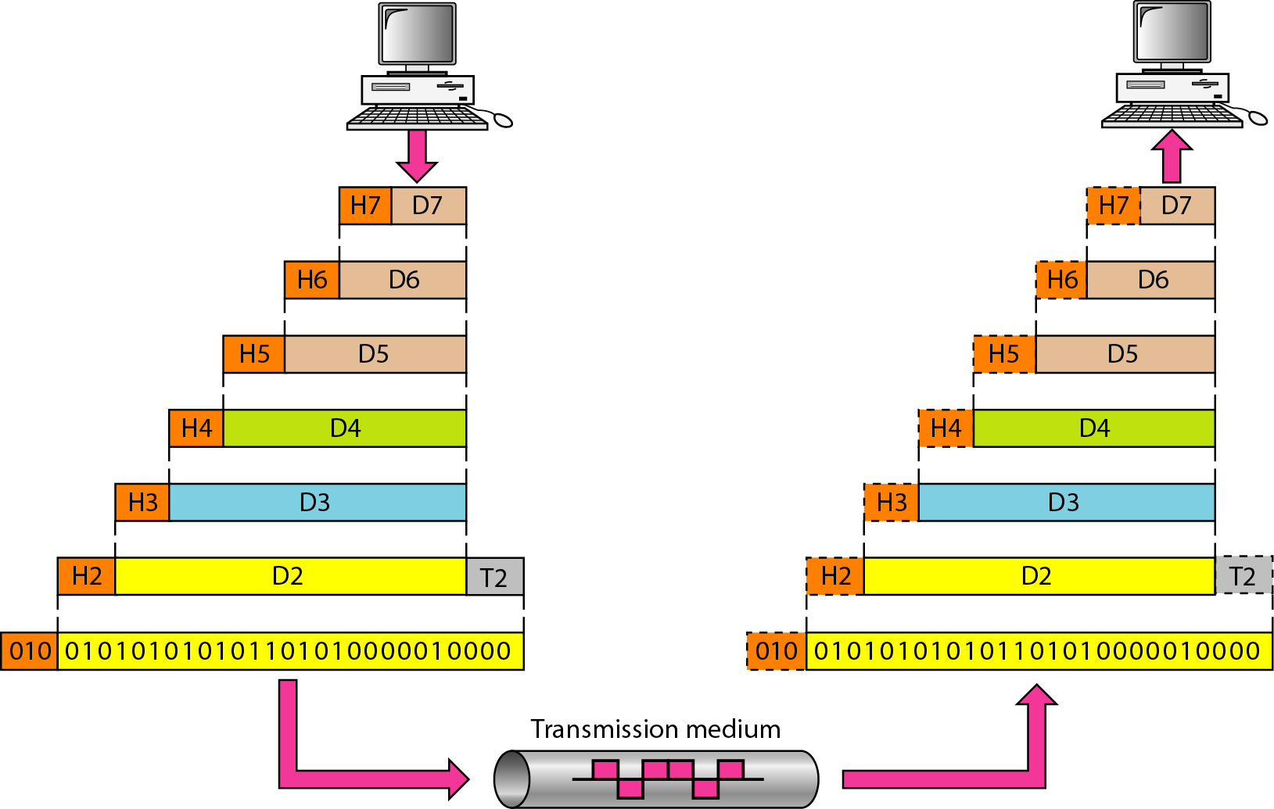
Figure 2.4 An exchange using the OSI model

Slide 11
2-3 LAYERS IN THE OSI MODEL
In this section we briefly describe the functions of each layer in the OSI model.
Topics discussed in this section:
Physical Layer Data Link Layer
Network Layer
Transport Layer
Session Layer
Presentation Layer
Application Layer

Slide 12
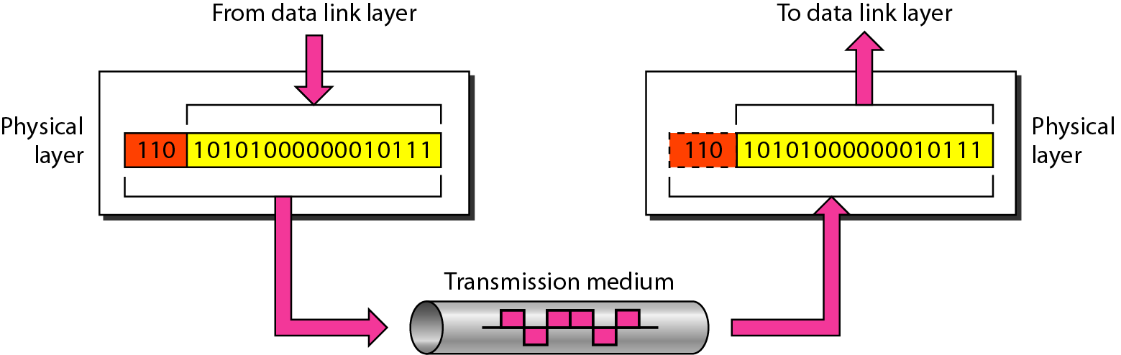
Figure 2.5 Physical layer

Slide 13
Note
The physical layer is responsible for movements of
individual bits from one hop (node) to the next.

Slide 14
The physical layer is also concerned with the following
Physical characteristics of interfaces and medium. It also defines the type of transmission medium.
Representation of bits.
Data rate.
Synchronization of bits.
Line configuration
Physical topology.
Transmission mode.

Slide 15
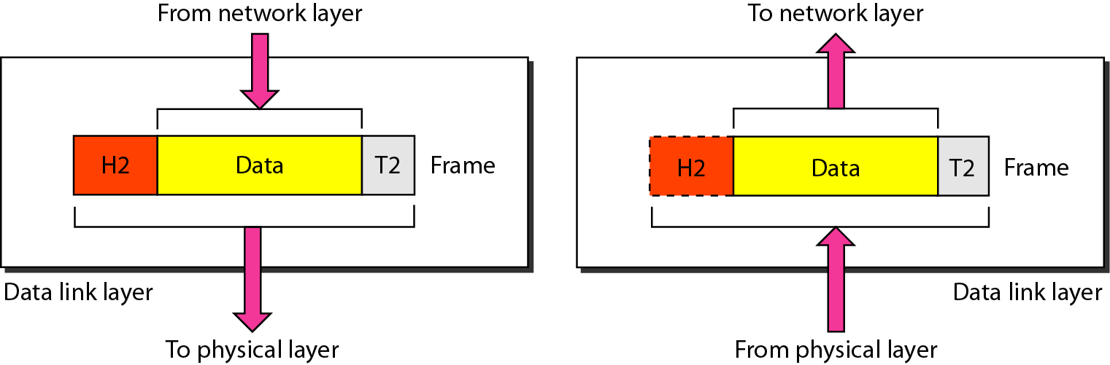
Figure 2.6 Data link layer

Slide 16
Note
The data link layer is responsible for moving frames from one hop (node) to the next.

Slide 17
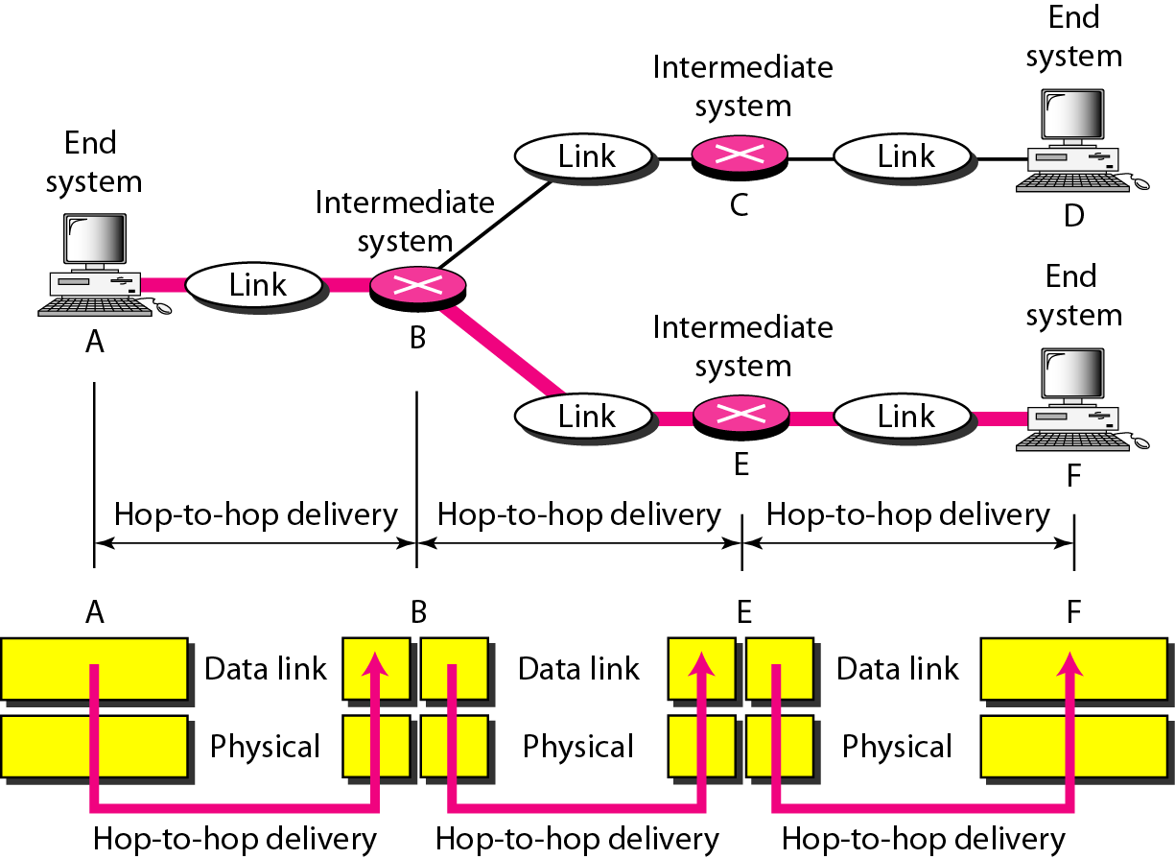
Figure 2.7 Hop-to-hop delivery

Slide 18
Other responsibilities of the data link layer include the following:
Framing
Physical addressing
Flow control
Error control
Access control

Slide 19
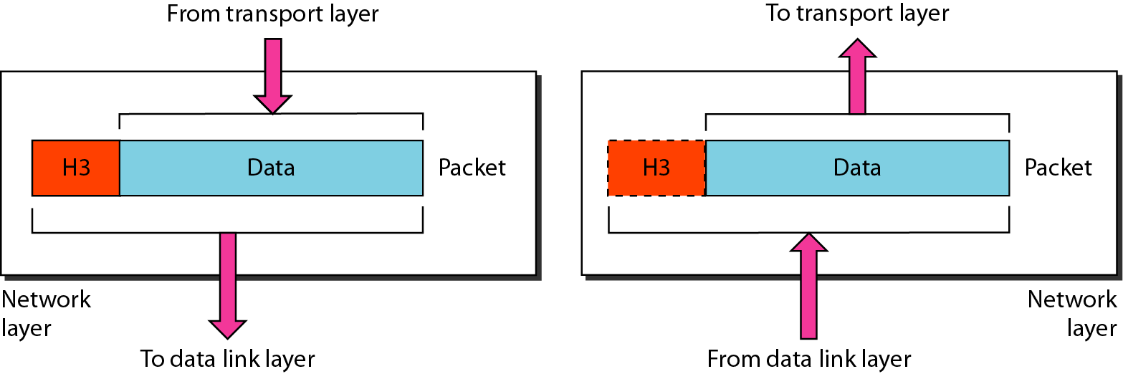
Figure 2.8 Network layer

Slide 20
Note
The network layer is responsible for the delivery of individual packets from
the source host to the destination host.

Slide 21
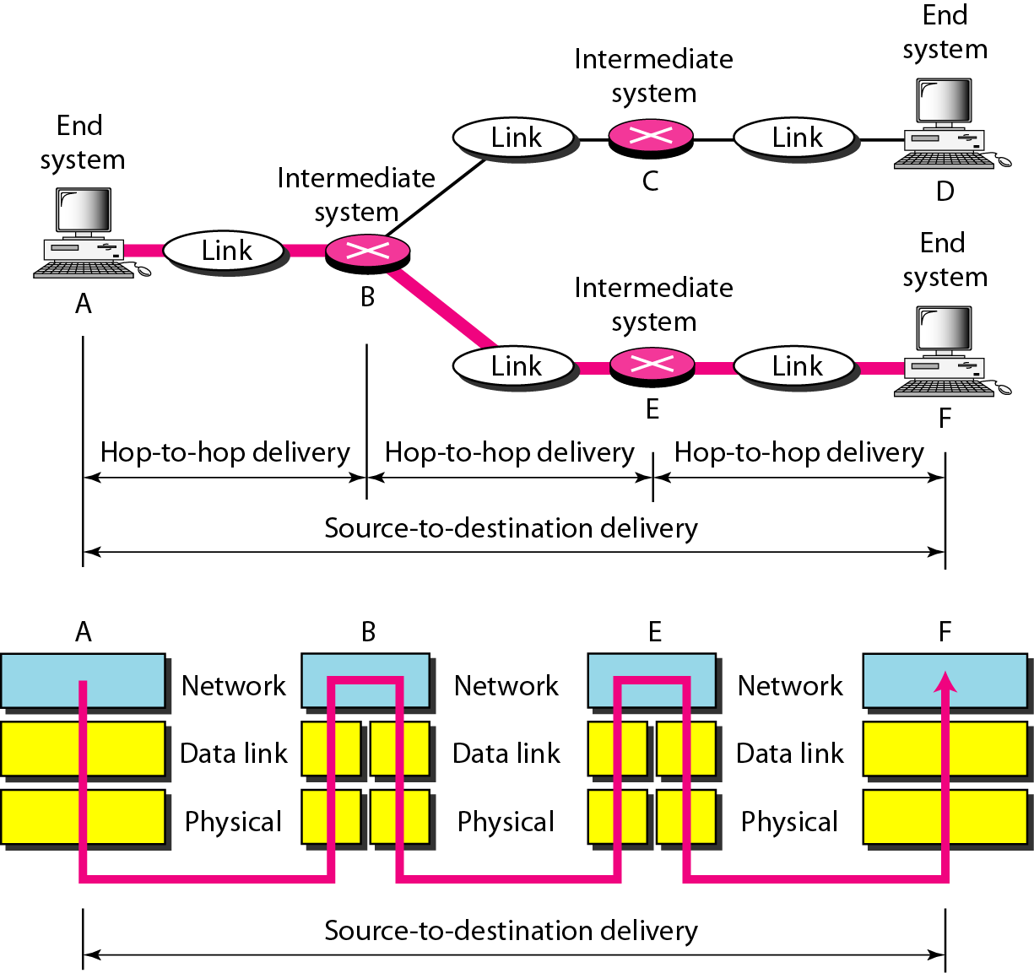
Figure 2.9 Source-to-destination delivery

Slide 22
Other responsibilities of the network layer include the following:
Logical addressing
Routing

Slide 23
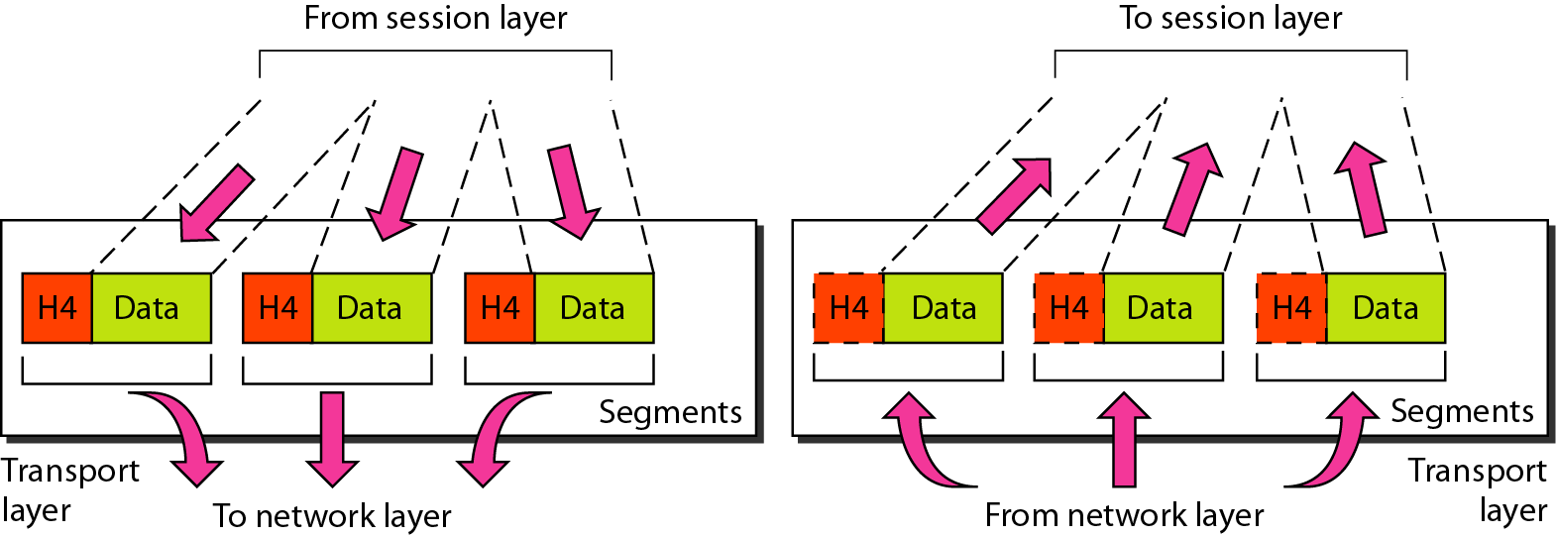
Figure 2.10 Transport layer

Slide 24
Note
The transport layer is responsible for the delivery of a message from one process to another.
A process is an application program running on a host

Slide 25
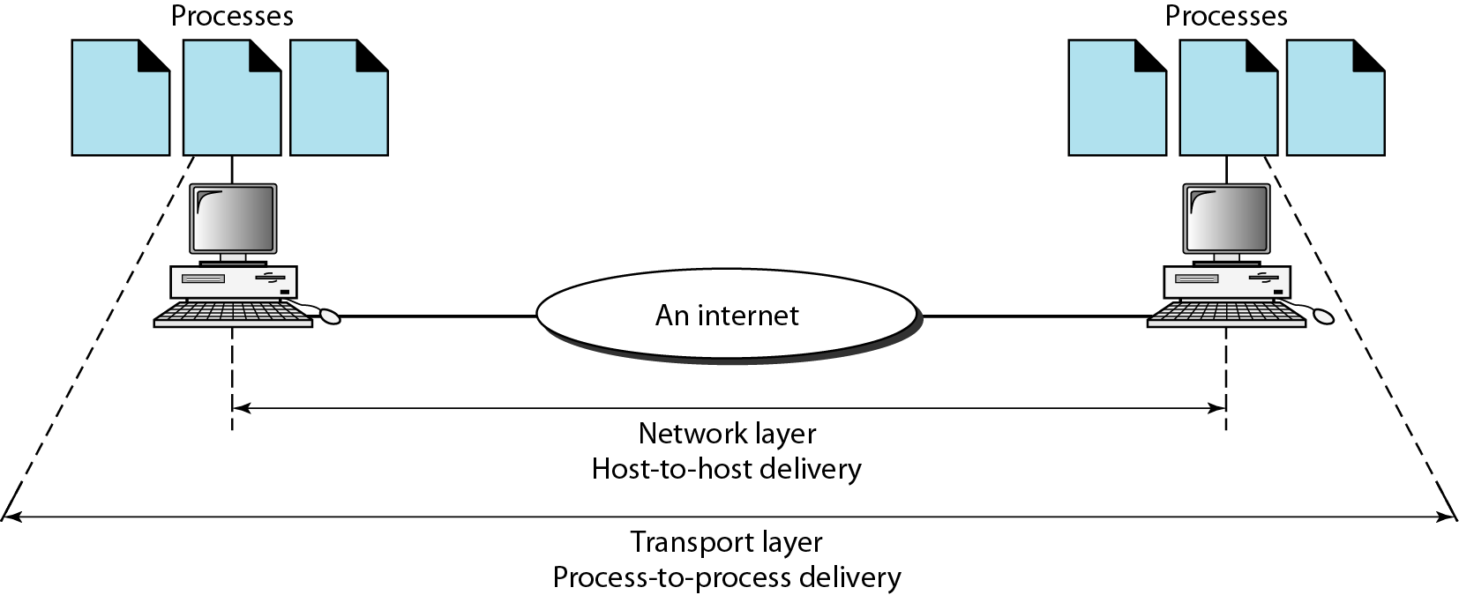
Figure 2.11 Reliable process-to-process delivery of a message

Slide 26
Other responsibilities of the transport layer include the following:
Service-point addressing
Segmentation and reassembly
Connection control
Error control
Flow control

Slide 27
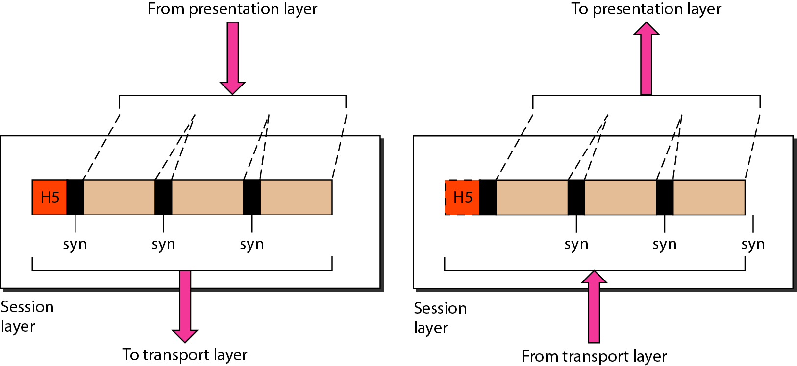
Figure 2.12 Session layer

Slide 28
Note
The session layer is responsible for dialog control and synchronization.

Slide 29
Specific responsibilities of the session layer include the following:
Dialog control
Synchronization

Slide 30
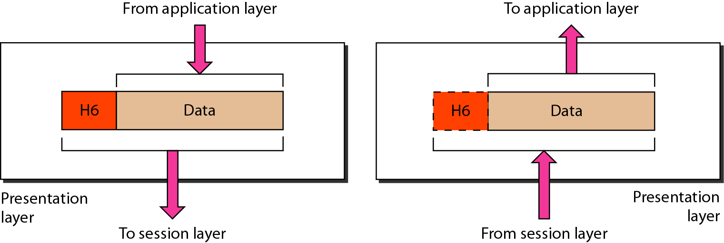
Figure 2.13 Presentation layer
The presentation layer is concerned with the syntax and semantics of the information exchanged between two systems.

Slide 31
Note
The presentation layer is responsible for translation, compression, and encryption.

Slide 32
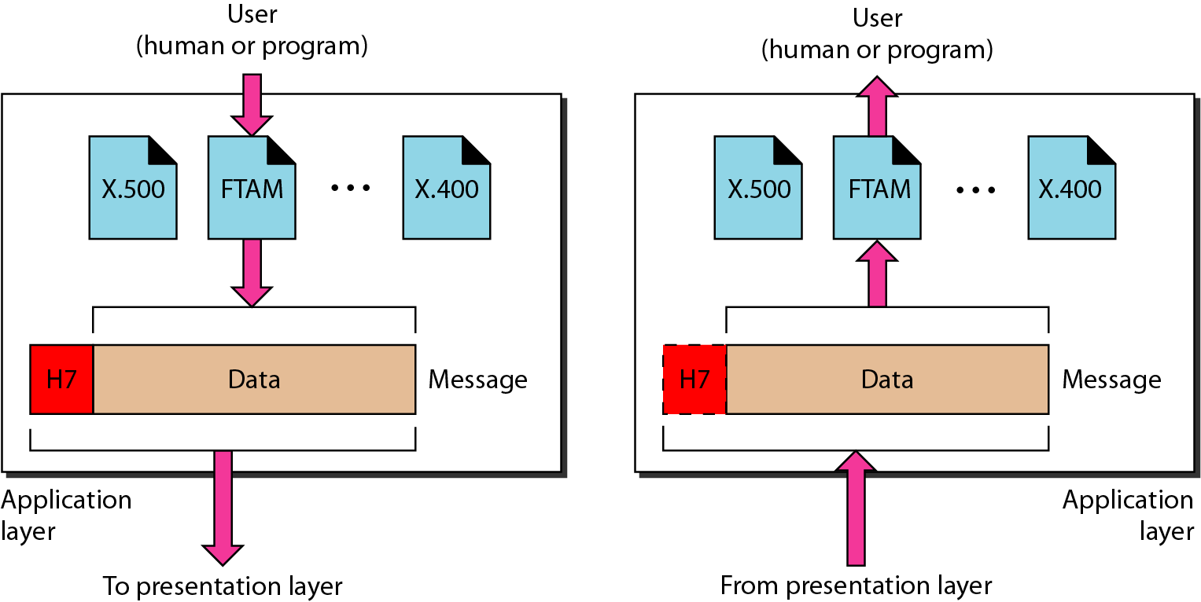
Figure 2.14 Application layer

Slide 33
Note
The application layer is responsible for providing services to the user.

Slide 34
Specific services provided by the application layer include the following:
Network virtual terminal
File transfer, access, and management
Mail services
Directory services

Slide 35
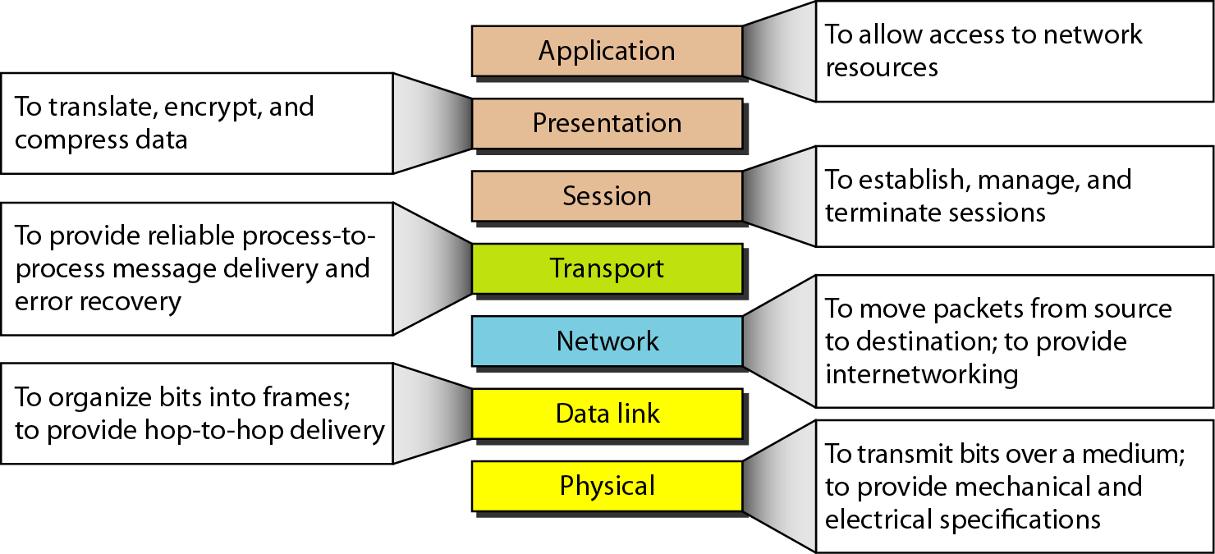
Figure 2.15 Summary of layers

Slide 36
2-4 TCP/IP PROTOCOL SUITE
The layers in the TCP/IP protocol suite do not exactly match those in the OSI model. The original TCP/IP protocol suite was defined as having four layers: host-to-network, internet, transport, and application. However, when TCP/IP is compared to OSI, we can say that the TCP/IP protocol suite is made of five layers: physical, data link, network, transport, and application.
Topics discussed in this section:
Physical and Data Link Layers Network Layer Transport Layer
Application Layer

Slide 37
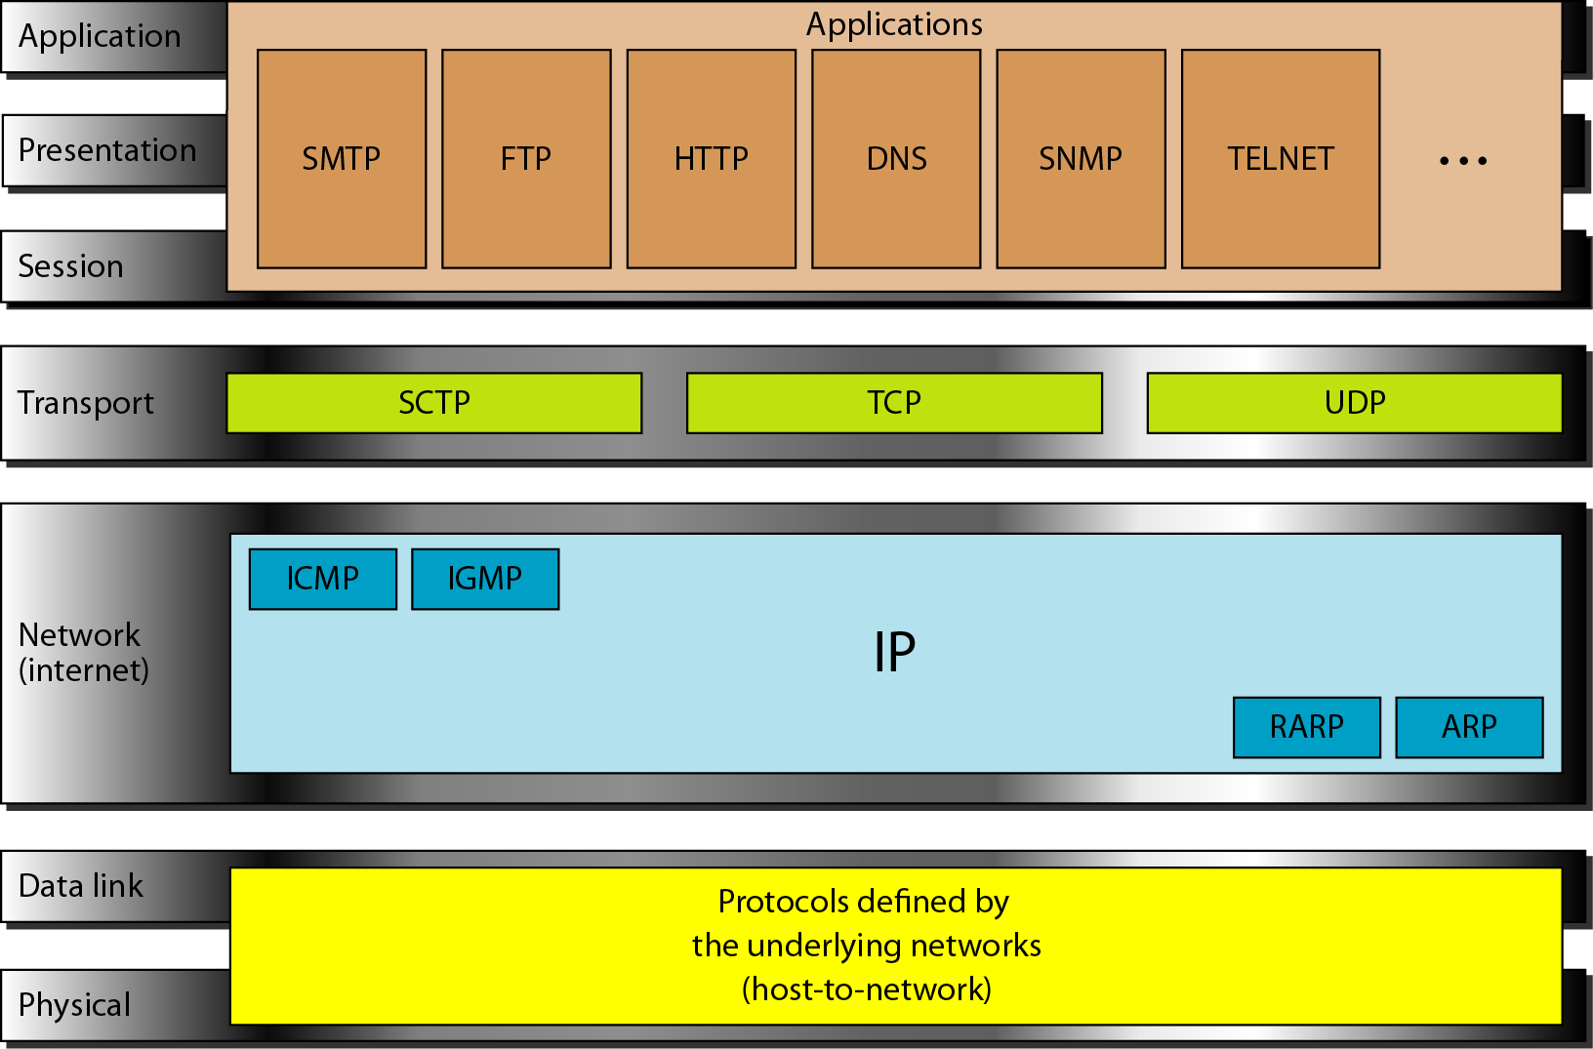
Figure 2.16 TCP/IP and OSI model

Slide 38
2-5 ADDRESSING
Four levels of addresses are used in an internet employing the TCP/IP protocols: physical, logical, port, and specific.
Topics discussed in this section:
Physical Addresses Logical Addresses Port Addresses Specific Addresses

Slide 39
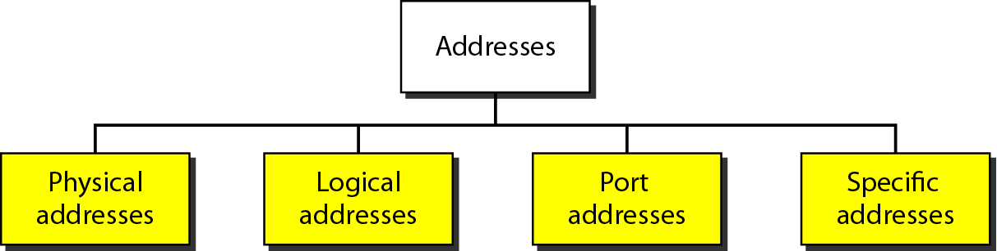
Figure 2.17 Addresses in TCP/IP

Slide 40
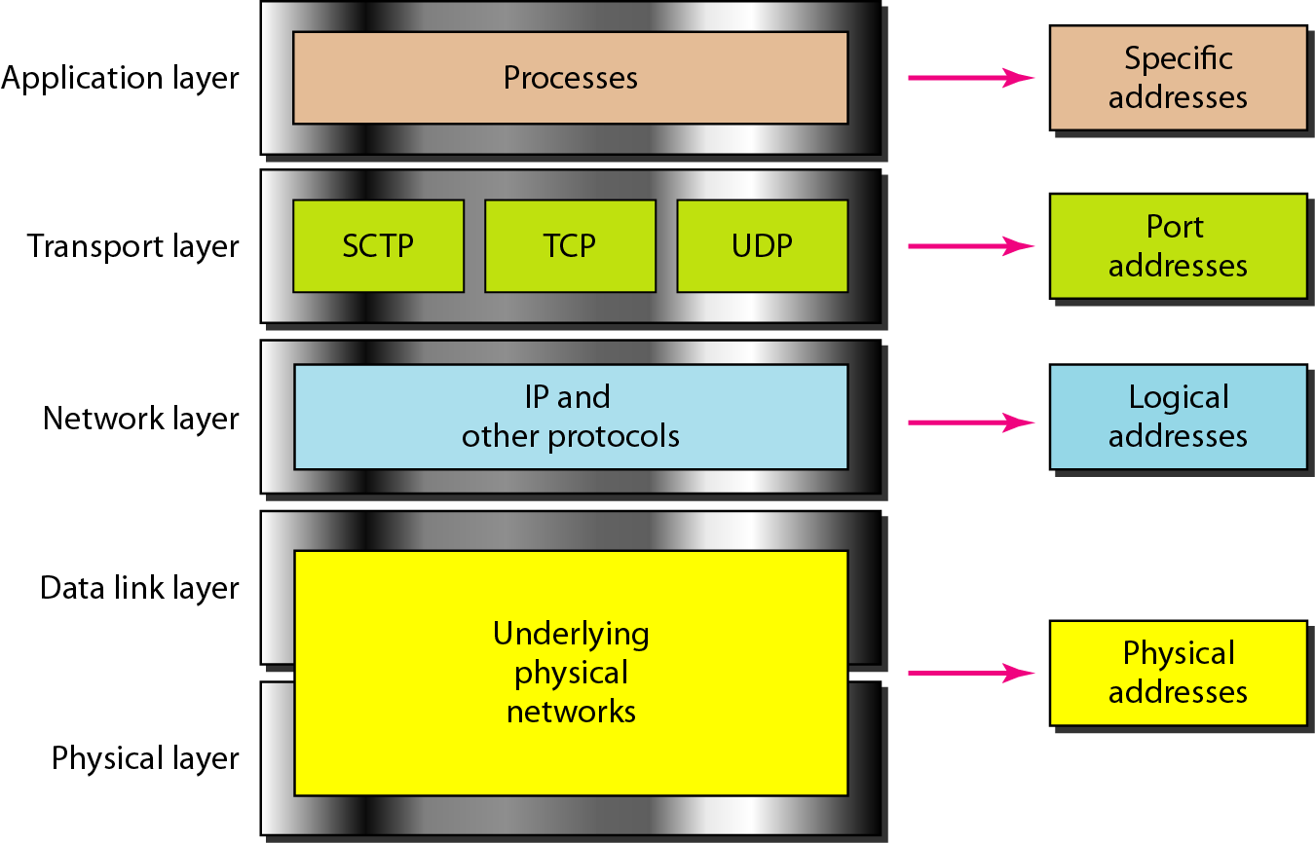
Figure 2.18 Relationship of layers and addresses in TCP/IP

Slide 41
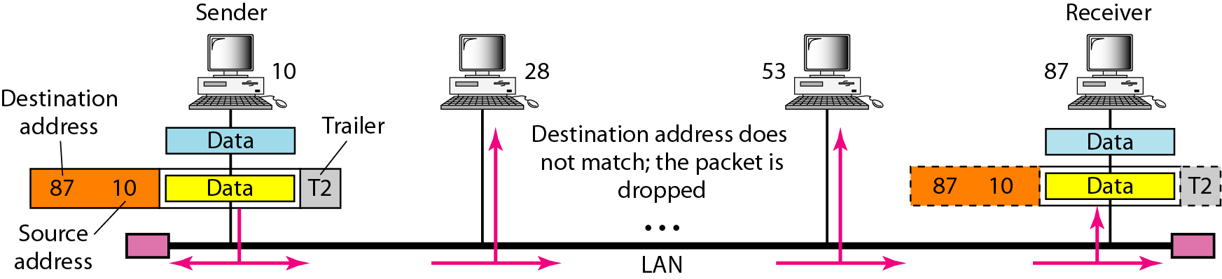
Figure 2.19 Physical addresses
In Figure 2.19 a node with physical address 10 sends a frame to a node with physical address 87. The two nodes are connected by a link (bus topology LAN). As the figure shows, the computer with physical address 10 is the sender, and the computer with physical address 87 is the receiver.

Slide 42
Example 2.2
Most local-area networks use a 48-bit (6-byte) physical address written as 12 hexadecimal digits; every byte (2 hexadecimal digits) is separated by a colon, as shown below:
07:01:02:01:2C:4B
A 6-byte (12 hexadecimal digits) physical address.

Slide 43
Example 2.3
Figure 2.20 shows a part of an internet with two routers connecting three LANs. Each device (computer or router) has a pair of addresses (logical and physical) for each connection. In this case, each computer is connected to only one link and therefore has only one pair of addresses. Each router, however, is connected to three networks (only two are shown in the figure). So each router has three pairs of addresses, one for each connection.

Slide 44
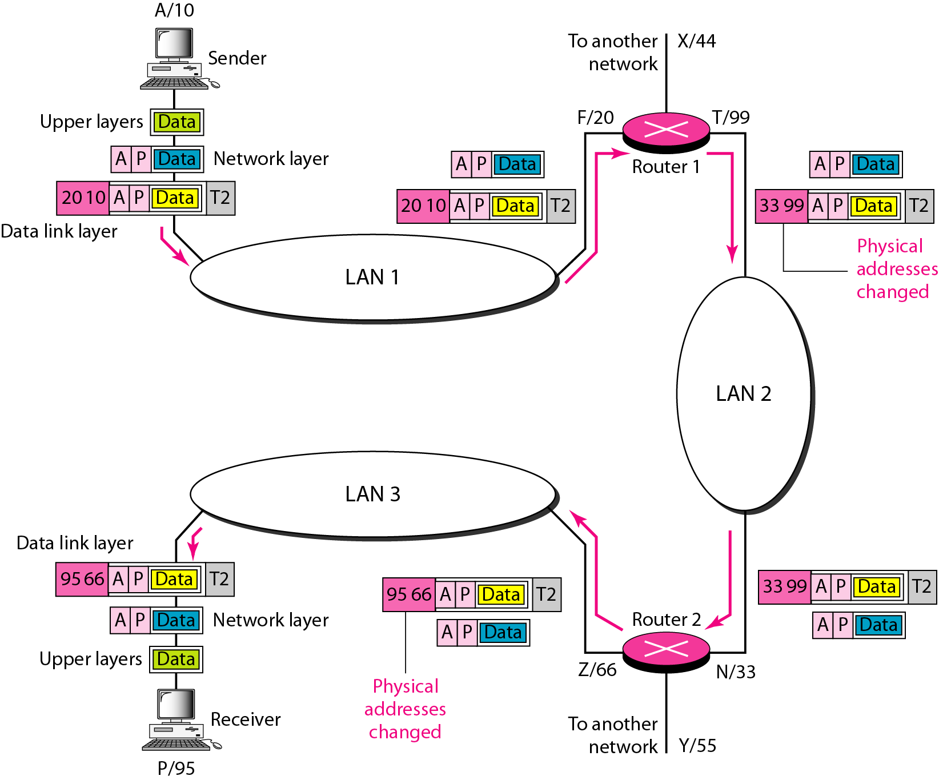
Figure 2.20 IP addresses

Slide 45
Example 2.4
Figure 2.21 shows two computers communicating via the Internet. The sending computer is running three processes at this time with port addresses a, b, and c. The receiving computer is running two processes at this time with port addresses j and k. Process a in the sending computer needs to communicate with process j in the receiving computer. Note that although physical addresses change from hop to hop, logical and port addresses remain the same from the source to destination.

Slide 46
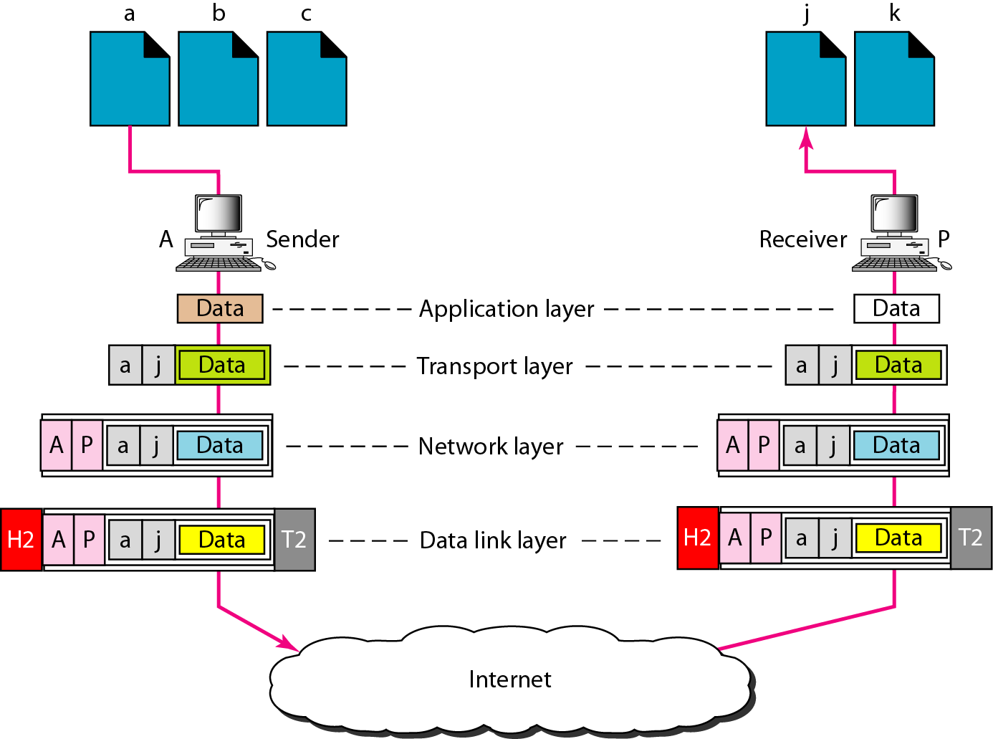
Figure 2.21 Port addresses

Slide 47
Note
The physical addresses will change from hop to hop,
but the logical addresses usually remain the same.

Slide 48
Example 2.5
A port address is a 16-bit address represented by one decimal number as shown.
753
A 16-bit port address represented as one single number.

Slide 49
THE ORIGINS OF THE INTERNET
The origins of the internet are rooted in the USA of the 1950s. The Cold War was at its height and huge tensions existed between North America and the Soviet Union.
Both superpowers were in possession of deadly nuclear weapons, and people lived in fear of long-range surprise attacks. The US realized it needed a communications system that could not be affected by a Soviet nuclear attack.
At this time, computers were large, expensive machines exclusively used by military scientists and university staff.

Slide 50
THE ORIGINS OF THE INTERNET
These machines were powerful but limited in numbers, and researchers grew increasingly frustrated: they required access to the technology, but had to travel great distances to use it.
To solve this problem, researchers started ‘time-sharing’. This meant that users could simultaneously access a mainframe computer through a series of terminals, although individually they had only a fraction of the computer’s actual power at their command.
The difficulty of using such systems led various scientists, engineers and organizations to research the possibility of a large-scale computer network.

Slide 51
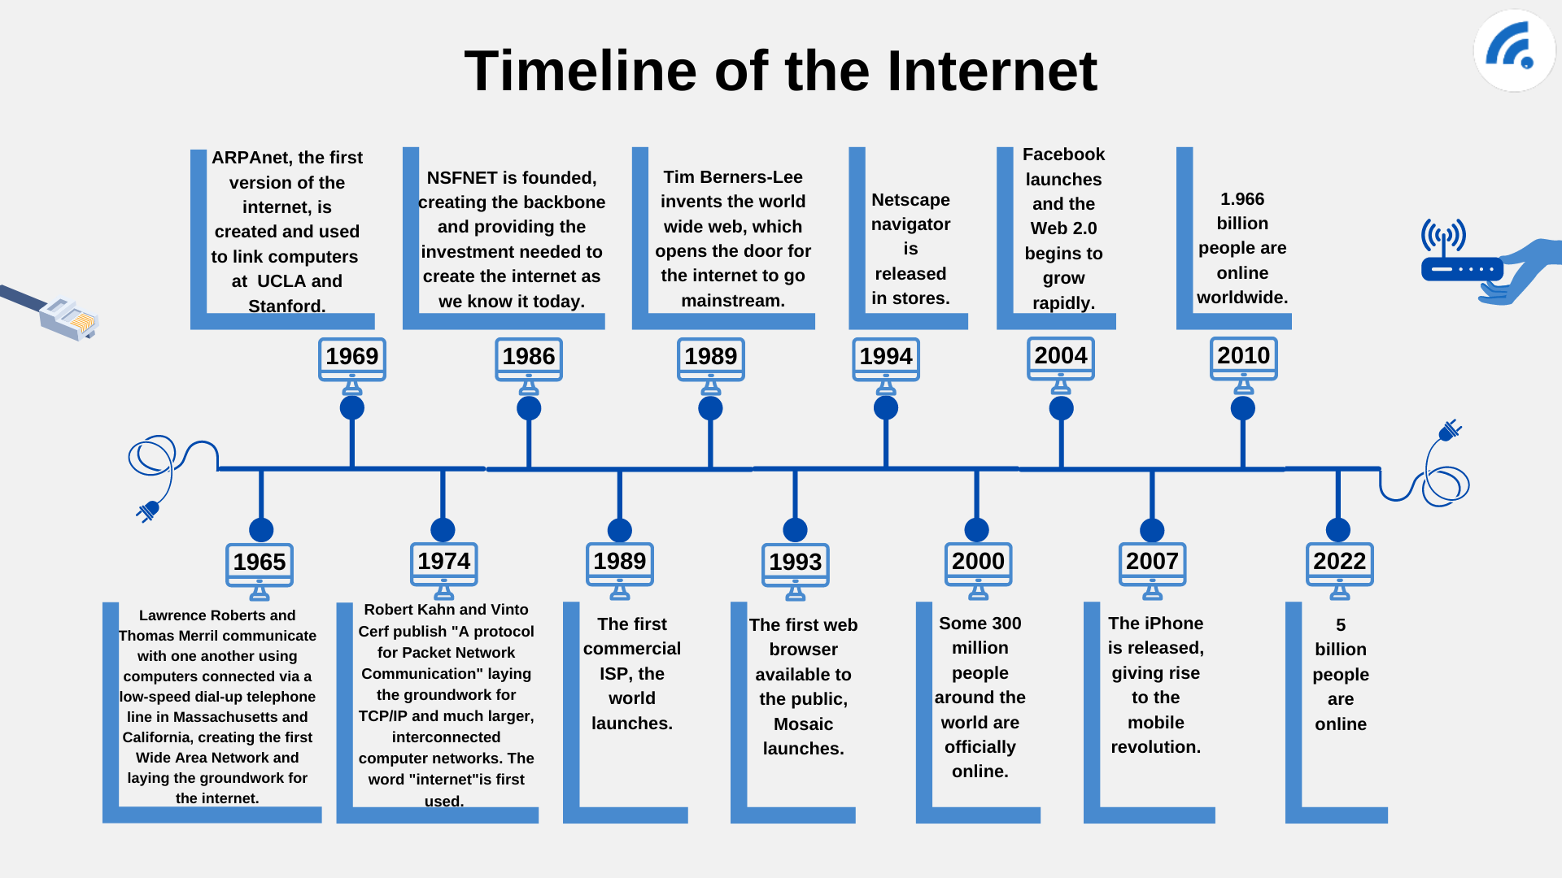

Slide 52
Evolution
The concept of Internet was originated in 1969 and has undergone several technological & Infrastructural changes as discussed below:
The origin of Internet devised from the concept of Advanced Research Project Agency Network (ARPANET).
ARPANET was developed by United States Department of Defense.
Basic purpose of ARPANET was to provide communication among the various bodies of government.
Initially, there were only four nodes, formally called Hosts.
In 1972, the ARPANET spread over the globe with 23 nodes located at different countries and thus became known as Internet.
By the time, with invention of new technologies such as TCP/IP protocols, DNS, WWW, browsers, scripting languages etc. Internet provided a medium to publish and access information over the web.

Slide 53
Internet Design Principles
The success and fast expansion of the Internet has been due to three critical design principles: openness, access, and end-to-end. Borrowing from the Internet Society (ISOC) definition and the author Stephen Krasner, a principle is understood as “beliefs of fact, causation, and rectitude”. These three principles are the cornerstone for the pervasive and ubiquitous internet uses in our daily lives today.

Slide 54
Openness
The first principle is ‘openness’.
Openness can have multiple meanings for different stakeholders.
One common understanding of openness can refer to technical standards. Another understanding for openness is the open and transparent process on deciding how the Internet should operate.
This practice translates to minimal barriers to participation and access to information. Concerning Open standards, these are developed transparently and are non-proprietary by organizations such as the Internet Engineering Task Force (IETF), the Internet Research Task Force (IRTF) and the Internet Architecture Board (IAB).
The standards that are developed are essential to enabling devices, services and applications to work together on a wide and dispersed network of networks, thus ensuring interoperability.

Slide 55
Access
The second principle is access, this is a key design feature since the birth of the Internet that has allowed for its growth and expansion.
The ‘access’ principle can be understood as no single entity or small collection of individuals can control the network as described by Leslie Daigle’s 2015 article On the Nature of the Internet.

Slide 56
End-to-end
Lastly, the end-to-end principle is a key feature to ensure the reliability of the network.
To reference ISCO, this principle is understood as whenever possible, communications protocol operations should be defined to occur at the end-points of a communications system, or as close as possible to the resource being controlled”.

Slide 57
Internet Protocol:
IP is an unreliable and connectionless datagram protocol—a best-effort delivery service. The term best-effort means that IP packets can be corrupted, lost, arrive out of order, or delayed and may create congestion for the network.
The identifier used in the IP layer of the TCP/IP protocol suite to identify each device connected to the Internet is called the Internet address or IP address. An IPv4 address is a 32-bit address that uniquely and universally defines the connection of a host or a router to the Internet; an IP address is the address of the interface.

Slide 58
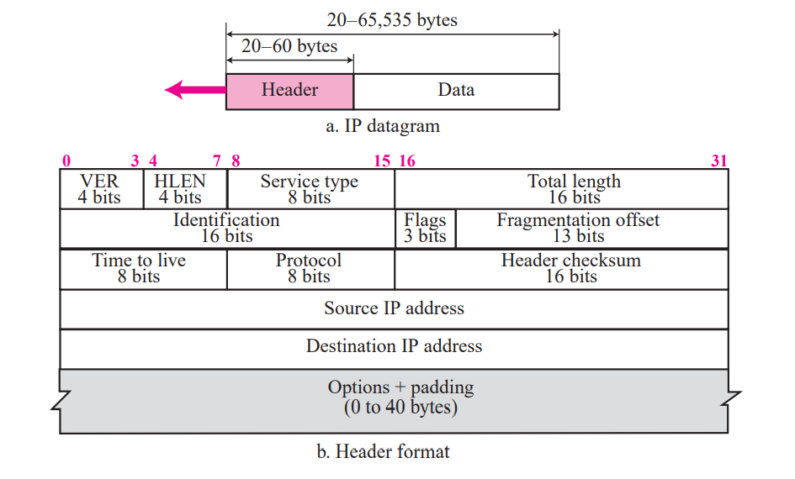
IP datagram

Slide 59
IPv4
IPv4 addresses are unique. They are unique in the sense that each address defines one, and only one, connection to the Internet. Two devices on the Internet can never have the same address at the same time. However, if a device has two connections to the Internet, via two networks, it has two IPv4 addresses. The IPv4 addresses are universal in the sense that the addressing system must be accepted by any host that wants to be connected to the Internet.

Slide 60
Address Space
A protocol like IPv4 that defines addresses has an address space. An address space is the total number of addresses used by the protocol. If a protocol uses b bits to define an address, the address space is 2b because each bit can have two different values (0 or 1). IPv4 uses 32-bit addresses, which means that the address space is 232 or 4,294,967,296 (more than four billion). Theoretically, if there were no restrictions, more than 4 billion devices could be connected to the Internet.

Slide 61
Notation
There are three common notations to show an IPv4 address: binary notation (base 2), dotted-decimal notation (base 256), and hexadecimal notation (base 16). The most prevalent, however, is base 256.

Slide 62
Binary Notation: Base 2
In binary notation, an IPv4 address is displayed as 32 bits. To make the address more readable, one or more spaces is usually inserted between each octet (8 bits). Each octet is often referred to as a byte. So it is common to hear an IPv4 address referred to as a 32-bit address, a 4-octet address, or a 4-byte address. The following is an example of an IPv4 address in binary notation:
01110101 10010101 00011101 11101010

Slide 63
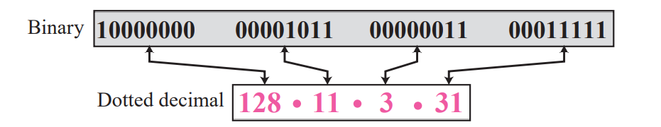
Dotted-Decimal Notation: Base 256
To make the IPv4 address more compact and easier to read, an IPv4 address is usually written in decimal form with a decimal point (dot) separating the bytes. This format is referred to as dotted-decimal notation.
Note that because each byte (octet) is only 8 bits, each number in the dotted-decimal notation is between 0 and 255.

Slide 64
Hexadecimal Notation: Base 16
We sometimes see an IPv4 address in hexadecimal notation. Each hexadecimal digit is equivalent to four bits. This means that a 32-bit address has 8 hexadecimal digits. This notation is often used in network programming.

Slide 65
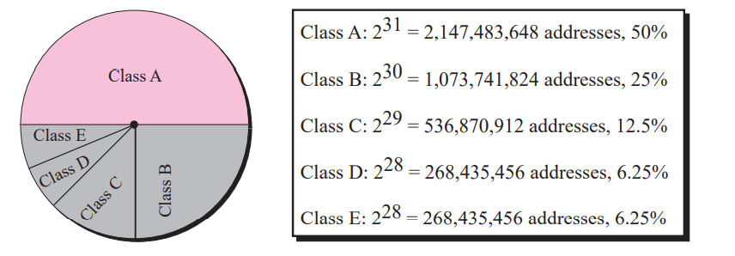
Classful Addressing
IP addresses, when started a few decades ago, used the concept of classes. This architecture is called classful addressing. In classful addressing, the IP address space is divided into five classes: A, B, C, D, and E. Each class occupies some part of the whole address space.

Slide 66
Thank You

